Slide 1


pes university
SUBMISSION REPORT
Simple linear regression on house prices
Submitted from: Batch 8 - C9
Submitted to: Arjun Anand Sir

Slide 2



TEAM MEMBERS
1
Mansi Jha - 44 - C9
2
Manas Agrawal - 21- C9
3
Mihika Tandon - 40 -C9
4
Mayuresh yalgi -4 -C9

Slide 3

Problem statement
System Requirements
Approach and Methodolgies
Input and Output Sample
TABLE OF CONTENTS
Output Sample
Challenges faced
Scope For Improvement

Slide 4
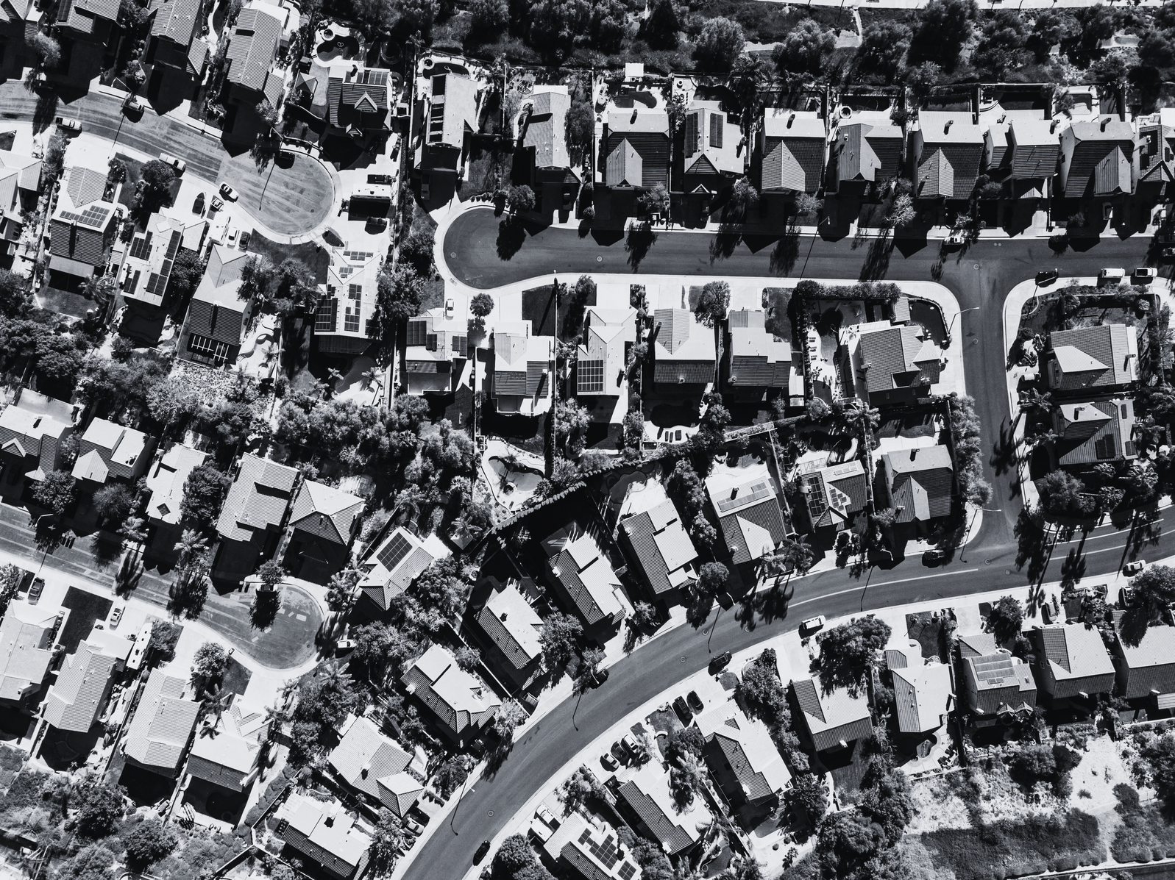
PROBLEM STATEMENT
The goal of this project is to build and evaluate a Linear Regression model to accurately predict the median house value in districts across California.
This is a supervised learning task where the target variable (y) is the house price, and the prediction is based on multiple independent features (X1,X2....Xn) like median income, house age, and population. The project involves:
1.Implementing a linear model from scratch using Gradient Descent.
2.Comparing the custom model's performance against the standard scikit-learn implementation.

Slide 5
numpy
pandas
matplotlib.pyplot
sklearn.datasets
MODULES USED
sklearn.model_selection
sklearn.linear_model
standardscaler

Slide 6




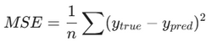
APPROACH AND METHODOLOGIES
1. Data Loading and Exploration
Data Preprocessing
Custom Model Implementation
The dataset was fetched using fetch_california_housing. It contains 20,640 samples and 8 features (MedInc, HouseAge, AveRooms, etc.).
Initial Visualization: A scatter plot was created to visualize the correlation between Median Income and House Value, confirming a positive linear relationship.
Normalization: Input features (X) were scaled using Min-Max Normalization to bring all values between 0 and 1. This step is critical for preventing gradient explosion and ensuring the model converges efficiently.
Splitting: The data was split into 80% training and 20% testing sets to evaluate performance on unseen data.
We implemented Linear Regression using Gradient Descent:
Hypothesis: y = w*x + b
Loss Function: Mean Squared Error (MSE) was used to quantify error.
Optimization: The weights (w) and bias (b) were updated iteratively over 30,000 epochs with a learning rate ($\alpha$) of 0.1 to minimize the loss.

Slide 7
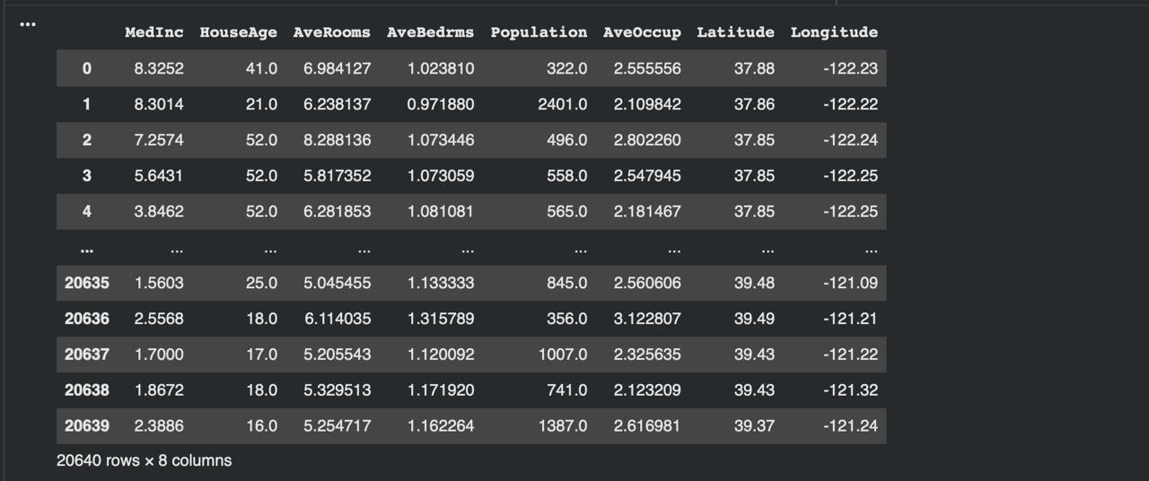
INPUT
California housing dataset

Slide 8
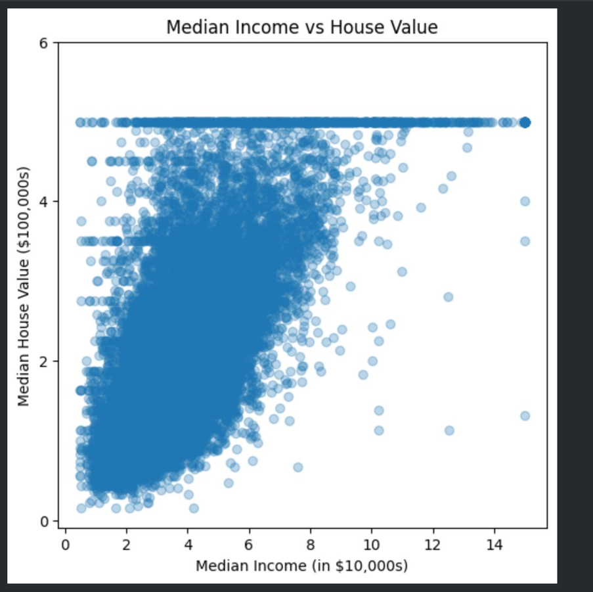
GRAPHICAL REPRESENTATION OF INPUT DATA

Slide 9
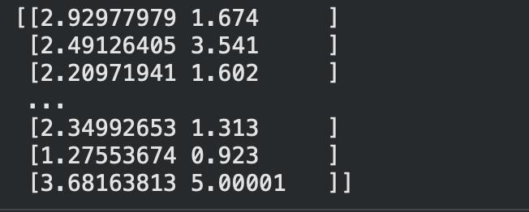
OUTPUT AFTER DOING GRADIENT DESCENT

Slide 10
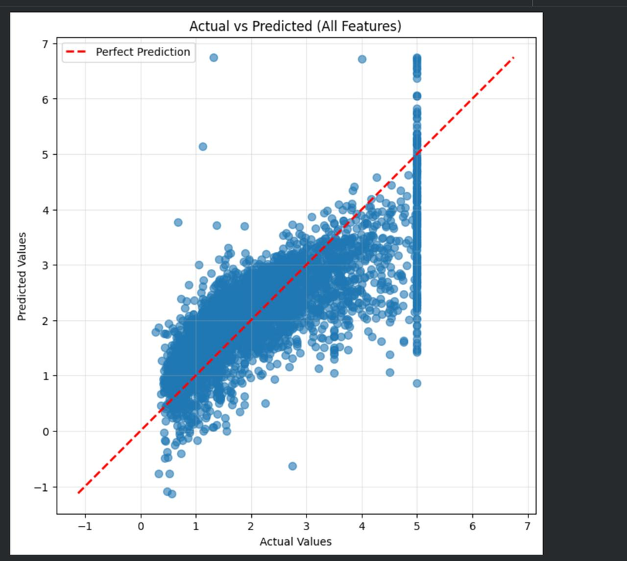
OUTPUT

Slide 11
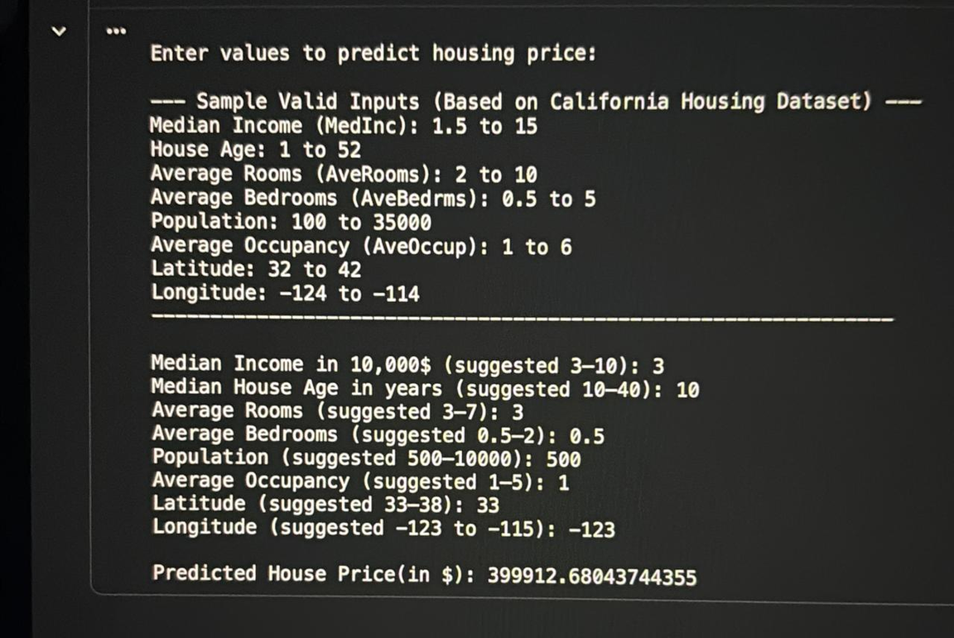
FINAL OUTPUT

Slide 12

CHALLENGES FACED
Data Scaling:
Hyperparameter Tuning:
Initially, without normalization, the Gradient Descent algorithm failed to converge because the features had vastly different ranges (e.g., population vs. income). Implementing MinMax scaling solved this.
Choosing the right learning rate was difficult; a rate too high caused the loss to fluctuate, while a rate too low made training too slow.
We solved it using trial and testing with different values until we reached a desired result
Impact of Outliers
Difficulty in understanding ML logic
Issue: The California Housing dataset contains values limited to $500,000. The outliers in the scatter plot that skewed the regression line.
Solution: We used the Actual vs. Predicted plot to visually identify these anomalies
The key challenge was the conceptual abstraction required to implement the core ML algorithm. It was difficult to intuitively grasp how the complex, multi-variable mathematical formulas for Gradient Descent (calculating partial derivatives of the loss function) actually resulted in the model learning

Slide 13
SCOPE FOR IMPROVEMENT
Increase Model Prediction Accuracy
Feature Engineering
Regularization:
Advanced Algorithms:
Although the model performs well, there is scope to reduce the Mean Squared Error further. This can be achieved by running the Gradient Descent for more epochs
Create new features, such as "bedrooms per room" or clustering locations based on Latitude/Longitude, which often improves the signal-to-noise ratio in housing data.
mplement Ridge (L2) or Lasso (L1) Regularization directly within the custom train_model function to prevent overfitting and stabilize the weights.
Explore non-linear models like Decision Trees or Random Forests for potentially higher prediction accuracy, as the relationship between house attributes and price is likely non-linear

